Slide 1
SDTM Annotated CRFs
“Lunch and Learn”
NOTE: Please view this presentation in Slide Show mode to enable functionality of links and slide builds.

Slide 2
SDTM Annotated CRFs:
Objectives for Today
To provide an opportunity to learn more about recently released documents pertaining to SDTM Annotated CRFs and ask questions regarding implementation and usage.
  Introduction
  SDTM aCRF Guidelines: Pre-Submission
  SDTM aCRF Guidelines: Submission
  Step by Step: Creating SDTM Annotated CRFs
  Procedural Training Highlights
  Next Steps/Future Enhancements
Company Confidential ©2015 Eli Lilly and Company

Slide 3
INTRODUCTION
Company Confidential ©2015 Eli Lilly and Company

Slide 4
SDTM Annotated CRFs:
Recently Released Documents
SDTM Annotated CRF Guidelines
Provide guidance to:
  Those responsible for the creation and review of SDTM Annotated CRFs
  Enable conformance to industry guidance
  Create documentation in a consistent manner across the organization
Step by Step: Creating SDTM Annotated CRFs
Assist those responsible for annotating a CRF with the creation of annotations using Adobe Reader
Reminder: You may recall an announcement that was sent via email Dec2015. This could be helpful to refer to or forward to your colleagues as needed.
Company Confidential ©2015 Eli Lilly and Company

Slide 5
SDTM Annotated CRFs:
Location of Documents
Located on the Business Document Repository:
Topic: Data and Analysis Delivery
  Aligns with title of procedure
Sub-Topic: 1.4 Manage Final Data Documentation
  Aligns to section of procedure where requirements are addressed
Link to Business Document Repository:
http://lillynetcollaboration.global.lilly.com/sites/CDFTProcess/Business%20Document%20Repository/Forms/Data_Analysis_Delivery_View.aspx
Company Confidential ©2015 Eli Lilly and Company

Slide 6
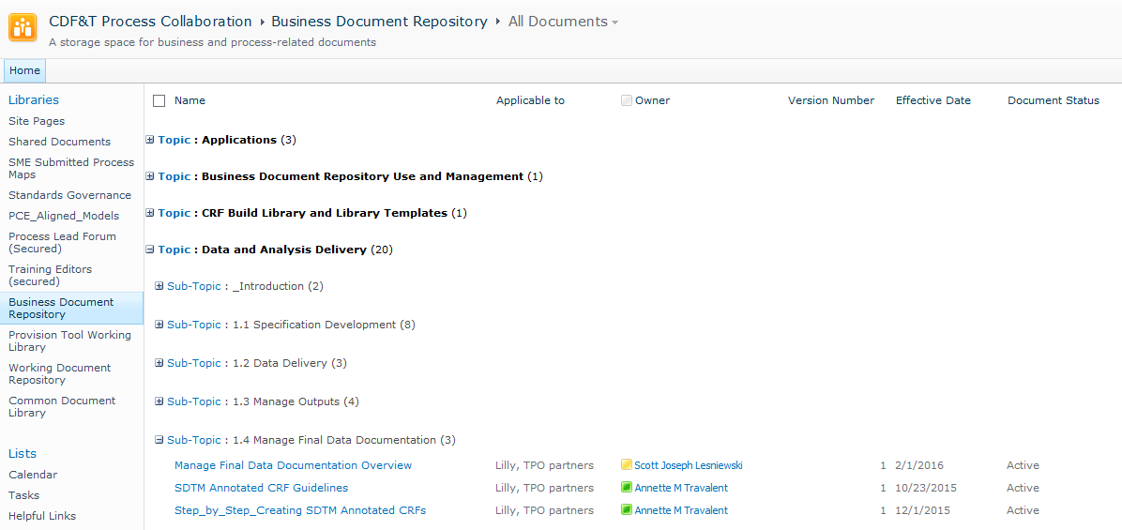
Business Document Repository
Company Confidential ©2015 Eli Lilly and Company

Slide 7
SECTION 1: BASIC PRINCIPLES FOR PRE-SUBMISSION
SDTM Annotated CRF Guidelines
Company Confidential ©2015 Eli Lilly and Company

Slide 8

SDTM aCRF Guidelines:
Section 1 Overview
Basic Principles for Pre-Submission
The SDTM Annotated CRF is used to support SDTM programming as well as dataset review.
General Rules
Appearance of Annotations
Domain Names
Domain Variables
CATEGORY Variables (--CAT, --SCAT)
--OBJ: OBJECT of the Observation
Findings Domains
Supplemental Qualifier Variables
Annotating RELREC Records
Annotations to Provide Additional Instruction
Data Collection Outside of eCRFs (ePRO, Diary)
Link to aCRF Guidelines
Company Confidential ©2015 Eli Lilly and Company

Slide 9
SDTM aCRF Guidelines:
Knowledge Check #1
General Rules
When the SDTM Annotated CRF is created the document should be named which of the following:
  blankcrf.pdf
  acrf.pdf
  sdtm.pdf
  None of the above
Company Confidential ©2015 Eli Lilly and Company

Slide 10

SDTM aCRF Guidelines:
Knowledge Check #1 - Answer
General Rules
When the SDTM Annotated CRF is created the document should be named which of the following:
  blankcrf.pdf
  acrf.pdf
  sdtm.pdf
  None of the above
The correct answer is acrf.pdf as defined by the Study Data Technical Conformance Guide.
Hint: The answer can be found on Page 3 of the SDTM aCRF Guidelines under General Rules
Company Confidential ©2015 Eli Lilly and Company

Slide 11
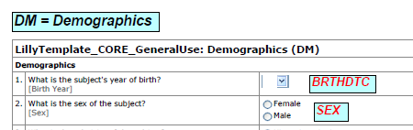
SDTM aCRF Guidelines:
Section 1 Overview
Appearance of Annotations
Annotation Font Color and Size
Arial, Bold, Italic
  Domains – Black, 12pt
  Variables – Red, 10pt
Company Confidential ©2015 Eli Lilly and Company

Slide 12
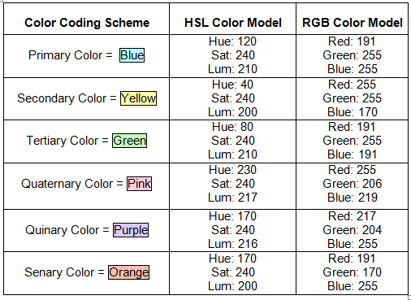

SDTM aCRF Guidelines:
Section 1 Overview
Appearance of Annotations
Annotation Color Coding
  Each domain and all of its variables should be color-coded using the same color scheme.
Company Confidential ©2015 Eli Lilly and Company

Slide 13
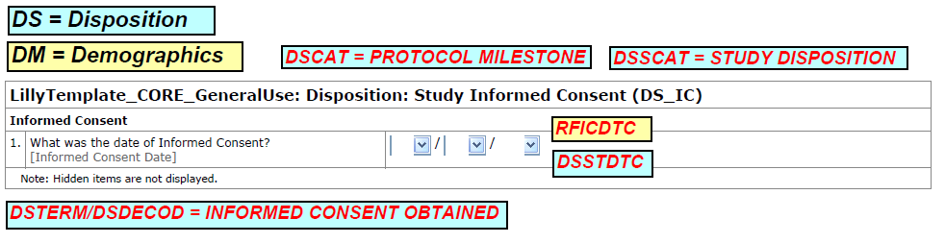
SDTM aCRF Guidelines:
Section 1 Overview
Appearance of Annotations
Annotation Color Coding
  If two or more domains exist on a single page then they should use different color schemes.
  The color coding scheme will be reset for each unique CRF page.
Company Confidential ©2015 Eli Lilly and Company

Slide 14
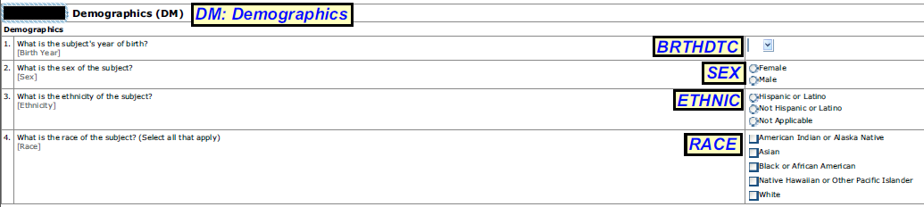
SDTM aCRF Guidelines:
Knowledge Check #2
Appearance of Annotations
Can you identify at least 3 issues with the SDTM annotated CRF below?
Company Confidential ©2015 Eli Lilly and Company

Slide 15
SDTM aCRF Guidelines:
Knowledge Check #2 - Answer
Appearance of Annotations
Text should be DM = Demographics
Hint: The answer can be found under Section 1.3 Domain Names on Page 5 of the SDTM aCRF Guidelines.
Domain Name text color should be black
Variable name text color should be red
Annotation fill in color should be light blue
Hint: These answers can be found under Section 1.2 Appearance of Annotations on Pages 4 and 5 of the SDTM aCRF Guidelines.
Company Confidential ©2015 Eli Lilly and Company

Slide 16
SDTM aCRF Guidelines:
Section 1 Overview
Domain Names
SUPPQUAL dataset names do not need to be annotated since SUPPQUAL variables are annotated as part of the main domain.
Domain Variables
Annotate variable names for all collected data fields, including any hidden fields on the CRF page.
Company Confidential ©2015 Eli Lilly and Company

Slide 17
SDTM aCRF Guidelines:
Section 1 Overview
CATEGORY Variables (--CAT, --SCAT)
May be “hidden items” on a CRF.
--OBJ: OBJECT of the Observation
An annotation for the FAOBJ variable should be included for CRFs that are mapped to the Findings About domain.
Findings Domains
Not necessary to include an annotation for --TEST
Company Confidential ©2015 Eli Lilly and Company

Slide 18


SDTM aCRF Guidelines:
Knowledge Check #3
Supplemental Qualifier Variables
This is an incorrect annotation for a Supplemental Qualifier Variable per the Guidelines. What should it be?
It should be:
Hint: The answer can be found under Section 1.8 Supplemental Qualifier Variables on Page 8 of the SDTM aCRF Guidelines.
Company Confidential ©2015 Eli Lilly and Company

Slide 19
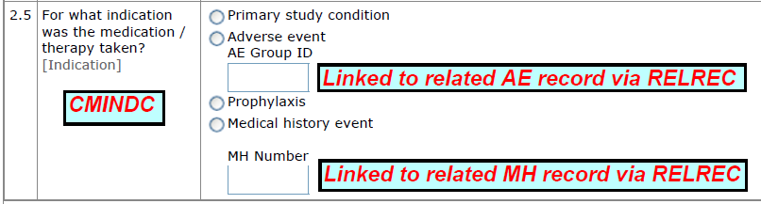
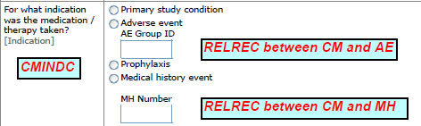
SDTM aCRF Guidelines:
Knowledge Check #4
Annotating RELREC Records
Are these correct annotations for RELREC records? What should they be?
Hint: The answer can be found under Section 1.9 Annotating RELREC Records on Page 9 of the SDTM aCRF Guidelines.
Company Confidential ©2015 Eli Lilly and Company

Slide 20
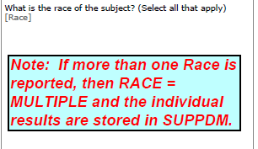
SDTM aCRF Guidelines:
Section 1 Overview
Annotations to Provide Additional Instruction
Include additional instructional text as space permits
Designed to provide guidance to reviewer
Company Confidential ©2015 Eli Lilly and Company

Slide 21

SDTM aCRF Guidelines:
Section 1 Overview
Data Collection Outside of eCRFs (ePRO, Diary)
For data that are not collected as part of the main CRF for a study (such as with ePRO devices) screenshots or other visualizations should be annotated and appended at the end of the annotated CRF.
  This is meaning from data collection forms that are not within the data collections system (eDC). Data collection tools may include case report forms (electronic or paper) and/or electronic instruments/devices (for example, patient reported outcomes) that collect data.
  No specific industry guidance available for how to include these data as part of the SDTM aCRF – e.g., 1 screenshot per page, multiple screenshots per page
Company Confidential ©2015 Eli Lilly and Company

Slide 22
SECTION 2: BASIC PRINCIPLES FOR SUBMISSION
SDTM Annotated CRF Guidelines
Company Confidential ©2015 Eli Lilly and Company

Slide 23

SDTM aCRF Guidelines:
Section 2 Overview
Basic Principles for Submission
The SDTM Annotated CRF is provided to assist Regulatory Reviewers with locating the origin of variables included in the SDTM datasets.
PDF File Version
Initial View
Bookmarking
Folder Location for Submission
Security Settings
Page Orientation
Page Sizing
Page Numbering
Document Optimization
The scope of the document includes both Pre-Submission and Submission Ready
Version 1.0 was released with emphasis on Pre-Submission
Company Confidential ©2015 Eli Lilly and Company

Slide 24
SDTM aCRF Guidelines:
Section 2 Overview
Basic Principles for Submission
The SDTM Annotated CRF is provided to assist Regulatory Reviewers with locating the origin of variables included in the SDTM datasets.
Why focus initially on Pre-Submission?
aCRFs need to be available earlier in the process – eg, for SDTM programming
*New roles are now responsible for the task*
The scope of the document includes both Pre-Submission and Submission Ready
Version 1.0 was released with emphasis on Pre-Submission
Link to Role Highlights
Company Confidential ©2015 Eli Lilly and Company

Slide 25
STEP BY STEP: CREATING SDTM ANNOTATED CRFS
Company Confidential ©2015 Eli Lilly and Company

Slide 26
Step by Step - Creating SDTM Annotated CRFs:
Introduction
Step by Step: Creating SDTM Annotated CRFs :
It is to assist with the creation of annotations using Adobe Reader.
Provides guidance on needed software and how to obtain it.
Document is divided into the following sections:
  Preparing to Start/Getting Started
  Creating Annotations/Annotation Text Boxes
  Using Data Element Definition (DEDs) to Assist with Creating Annotations
Company Confidential ©2015 Eli Lilly and Company

Slide 27
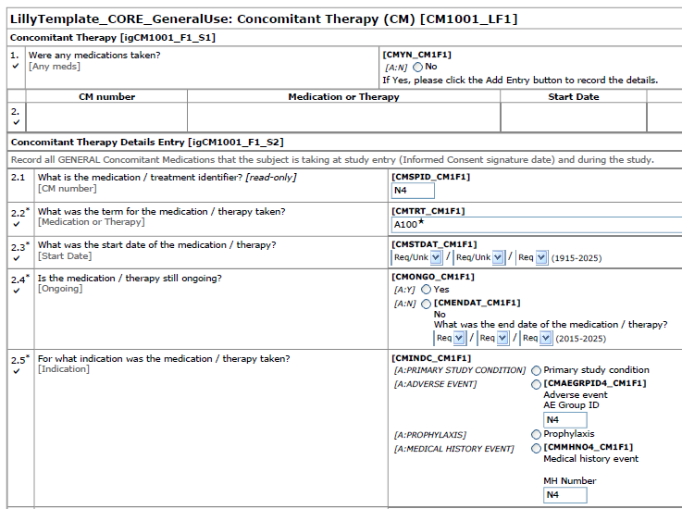
Step by Step - Creating SDTM Annotated CRFs:
Preparing to Start
The Annotated Study Book (ASB) may include annotations specific to InForm:
Form RefNames
Item RefNames
Item attributes such as data type and length
Correspond to the metadata in the Data Element Definitions (DEDs)
Also typically correspond to the variables in the raw datasets
Company Confidential ©2015 Eli Lilly and Company

Slide 28
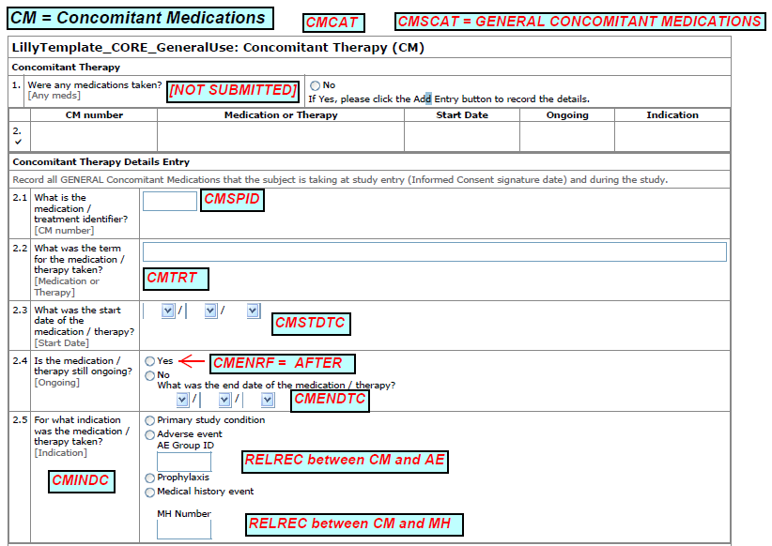
Step by Step - Creating SDTM Annotated CRFs:
Preparing to Start
A “Clean” Study Book:
Does not contain all the annotation information specific to study build
Recommend this is the document used to create the SDTM Annotated CRF for the CRT Package
Company Confidential ©2015 Eli Lilly and Company

Slide 29
Step by Step - Creating SDTM Annotated CRFs:
Preparing to Start
It is important to obtain a copy of the study book in a specific format as noted below:
For InForm Studies Using Central Designer (Current Guidance Under Evaluation):
Obtain a copy of the study book (a collection of study specific unique CRFs) with no annotation information.
  Refer to study build process document: Annotated Study Book Options.
  Instruct the study build personnel providing the study book to select the “No Annotated Information” display option from the Annotated Study Book Options.
  Note: This process document is also located in the Business Document Repository under Topic: Study Build > Sub-Topic: Data Collection Tool Design.
For Studies Not Using InForm/Central Designer :
When using other platforms/systems ensure that the study book you obtain to create the SDTM annotated CRF is free from extraneous information (e.g., raw data annotations).
Company Confidential ©2015 Eli Lilly and Company

Slide 30
Step by Step - Creating SDTM Annotated CRFs:
Knowledge Check #5
Why is it important to begin with a study book that has no extraneous information on it?
It provides more space on the CRF page to add SDTM annotations.
The appearance of the CRF page is less cluttered to a regulatory reviewer.
It reduces the chance that a regulatory reviewer will ask for additional information (such as a request to see the raw datasets if the clinical database annotations are included).
All of the above.
Company Confidential ©2015 Eli Lilly and Company

Slide 31

Step by Step - Creating SDTM Annotated CRFs: Knowledge Check #5 - Answer
Why is it important to begin with a study book with no annotation or extraneous information on it?
It provides more space on the CRF page to add SDTM annotations.
The appearance of the CRF page is less cluttered to a regulatory reviewer.
It reduces the chance that a regulatory reviewer will ask for additional information (such as a request to see the raw datasets if the clinical database annotations are included).
All of the above.
Hint: The answer can be found under Section 1 Preparing to Start on Page 2 of the Step by Step Guidelines.
Company Confidential ©2015 Eli Lilly and Company

Slide 32
PROCEDURE, PROCEDURAL TRAINING AND BUSINESS PROCESS RESOURCES
Data and Analysis Delivery: 1.4 Manage Final Data Documentation
Company Confidential ©2015 Eli Lilly and Company

Slide 33
Final Data Documentation: Overview
  Blank case report form with SDTM annotations.
  SDTM annotations provide programmers and reviewers the raw to SDTM mappings.
Final Annotated CRFs
SAS Transport Files
  Open file format published by SAS to exchange data.
  Each dataset should be translated to an XPT file and be included in the final data documentation
Data Definition Documentation
Data Reviewer’s Guide
  Describes the content and structure of the data.
  Provides a list of the SAS transport files/datasets and a detailed description of the contents of each dataset.
  Provides additional information about the data including basic information about the study and a compliance summary.
Company Confidential ©2015 Eli Lilly and Company

Slide 34
Final Annotated CRFs
Roles responsible:
Specifications Developer and Code Author such as,
Programmer
Stat Analyst
Roles involved:
Clinical Data Associate
Data Solution Associate
Data Manager
SDTM/ADaM Consultant
Submission Consultant
  Blank case report form with SDTM annotations.
  SDTM annotations provide programmers and reviewers the raw to SDTM mappings.
Final Annotated CRFs
Example:
Company Confidential ©2015 Eli Lilly and Company

Slide 35
Final Annotated CRFs:
Process Requirements
Activity | Related Information | Responsible
Develop final annotated CRFs | The minimum requirements are for observed data needs only and include the following: Annotated CRFs are finalized and align with the final CRFs and observed datasets Final annotations are in alignment with applicable regulatory requirements. Documentation must meet the attributes defined in SEQS105 Documentation and Data. | Specifications Developer
Retain final documentation | The responsible party who executes the deliverable retains the final documentation. Retain documentation and programs in a secure, version-controlled location in compliance with the SEQSQ105-003 Records Management. | Code Author Specifications Developer
Company Confidential ©2015 Eli Lilly and Company

Slide 36





Final Annotated CRFs:
Benefits of Good aCRFs
Good final annotated CRFs:
Are completed as part of the study and not at time of submission. Studies may complete years prior to submission and completing annotations during the study contributes to a higher quality and more timely submission.
DESTINATION
        Have all fields on blank CRFs marked to provide accurate traceability from where the collected data field is mapped to the observed data being submitted.
SOURCE
      Follow the metadata submission and technical conformance guidelines (for example, only unique pages are included and annotated, file name is acrf.pdf).
Company Confidential ©2015 Eli Lilly and Company

Slide 37
Final Data Documentation: Resources
This concludes procedural training for Final Data Documentation. For additional information regarding this activity, please refer to the Data and Analysis Delivery Resource Listing.
Procedural Training Module | Activity | Type of Documentation | Process Documentation | Status | Location | Owner
1.4 | Manage Final Documentation | Procedural Training | Manage Final Data Documentation | Published | http://gen21.am.lilly.com/Courses_LRL/9092112/v1/9092112.ppt | Marisa Howard
 |  | Process Overview | Manage Final Data Documentation Overview | Published | Business Document Repository | Scott Lesniewski
 |  | Guidance Document | SDTM Annotated CRF Guidelines | Published | Business Document Repository | Annette Travelent
 |  | Step by Step Instructions | Step_by_Step_Creating SDTM Annotated CRFs | Published | Business Document Repository | Annette Travelent
Item ID: 9092112; V1.0
Company Confidential ©2015 Eli Lilly and Company

Slide 38
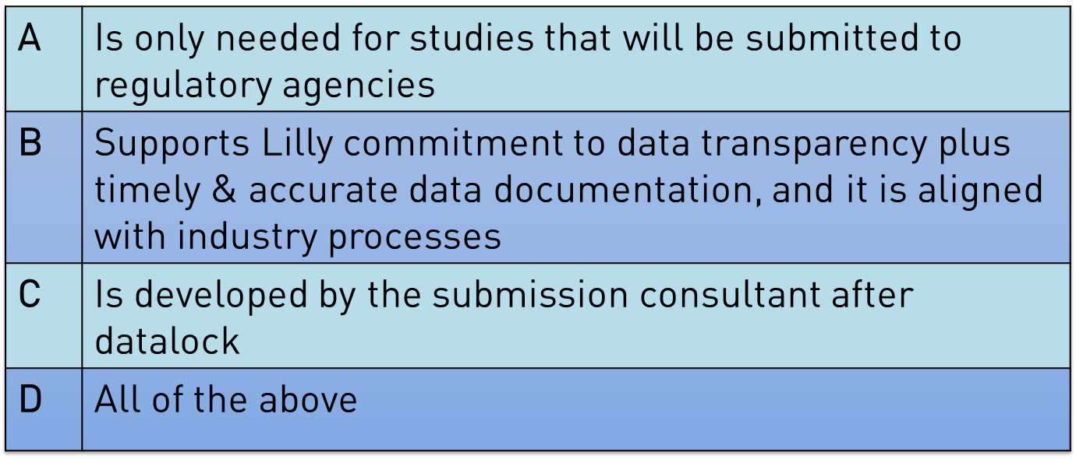
Knowledge Check #6
The final data documentation for the Case Report Tabulation (CRT) Package:
Company Confidential ©2016 Eli Lilly and Company
Notes:
CRT package is needed for transparency innitiative on top of submission as lilly has commited to it. The submission consultant is no longer accountable for this activity. So the right response is B

Slide 39
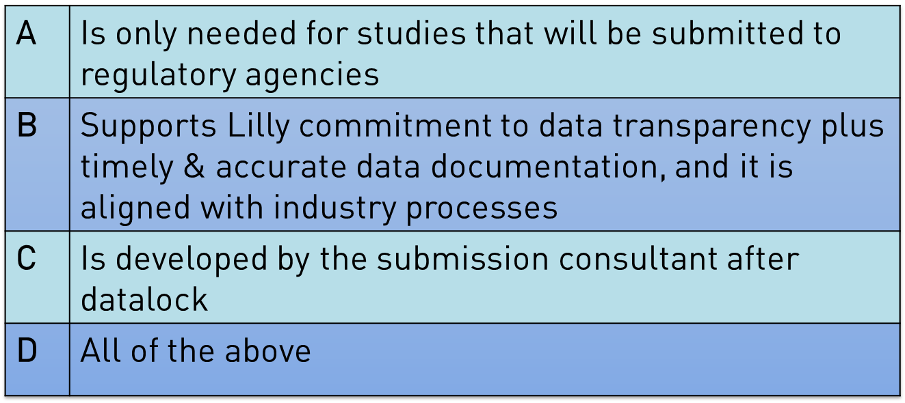

Knowledge Check #6 - Answer
The final data documentation for the Case Report Tabulation (CRT) Package:
Company Confidential ©2016 Eli Lilly and Company
Notes:
CRT package is needed for transparency innitiative on top of submission as lilly has commited to it. The submission consultant is no longer accountable for this activity. So the right response is B

Slide 40
NEXT STEPS
Company Confidential ©2015 Eli Lilly and Company

Slide 41
SDTM aCRFs:
Implementation of Guidelines
When should I start using these guidelines?
Active Studies: It is recommended that aCRFs are updated to conform to these guidelines. Study teams should evaluate the impact of timing for implementing these guidelines for ongoing studies.
New Studies: It is expected for new studies to follow/adhere to these guidelines.
Locked Studies: There is no expectation to go back and implement these guidelines if the SDTM Annotated CRF has already been delivered.
Company Confidential ©2015 Eli Lilly and Company

Slide 42

SDTM aCRFs:
Implementation Scenario #1
The planned submission date for our compound’s new indication is 2 months away. Should we have our vendors update all the SDTM aCRFs to align with these guidelines?
Company Confidential ©2015 Eli Lilly and Company

Slide 43

SDTM aCRFs:
Implementation Scenario #2
I have a new study with FPV in 3 months and have just started working with the SDTM vendor. This study is the last one planned for inclusion in an upcoming submission late next year. Should I have them follow these guidelines for the new study?
Company Confidential ©2015 Eli Lilly and Company

Slide 44

SDTM aCRFs:
Implementation Scenario #3
I have 6 Phase III studies planned for an eventual submission. Two studies are ongoing and have already delivered their SDTM aCRFs and the other 4 studies have FPV later this year. Should I have the vendor update the SDTM aCRF for the 2 studies already completed?
Company Confidential ©2015 Eli Lilly and Company

Slide 45
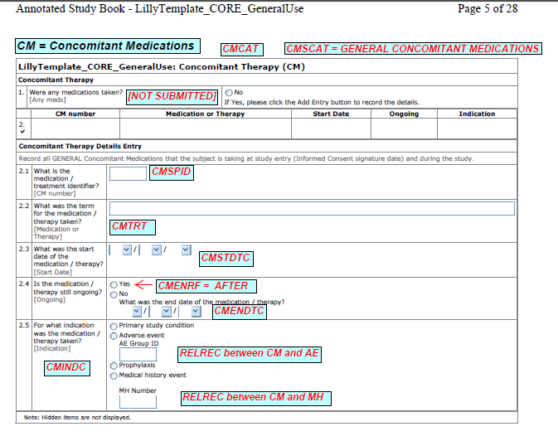

SDTM aCRFs:
Future Enhancements
Developing SDTM aCRF templates as part of CRF Build Library
SDTM aCRF will be included as another component of the CRF Build Library
Company Confidential ©2015 Eli Lilly and Company

Slide 46

SDTM aCRFs:
Who to Contact?
These documents are expected to evolve as industry and Lilly standards
change.
Periodic review will occur against the industry standard guidelines
to help stay aligned with the most current regulations.
For any questions or recommendations for changes, please contact the document owner:
Annette Travalent
Email: travalent_annette_m@lilly.com
Phone: 317-864-0507
Company Confidential ©2015 Eli Lilly and Company

Slide 47

Questions ?
Company Confidential ©2015 Eli Lilly and Company

Slide 48
BACK UP SLIDES
Company Confidential ©2015 Eli Lilly and Company

Slide 49
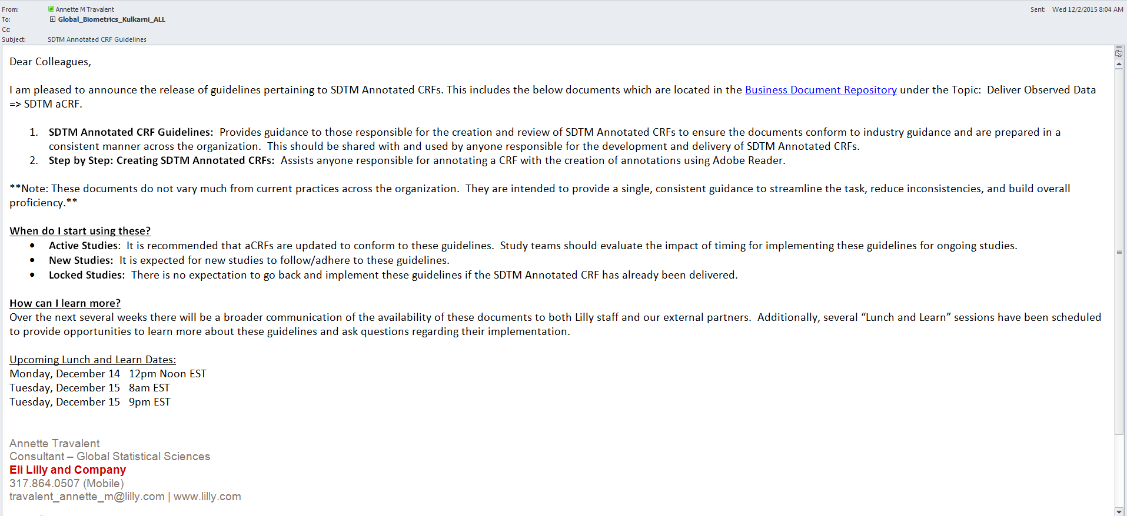
SDTM Annotated CRFs:
Email Communication
NOTE: Effective February 1, 2016 the documents were moved to the new Business Document Repository.
They are located under Topic: Data Analysis and Delivery > Sub-Topic: 1.4 Manage Final Data Documentation.
Company Confidential ©2015 Eli Lilly and Company

Slide 50
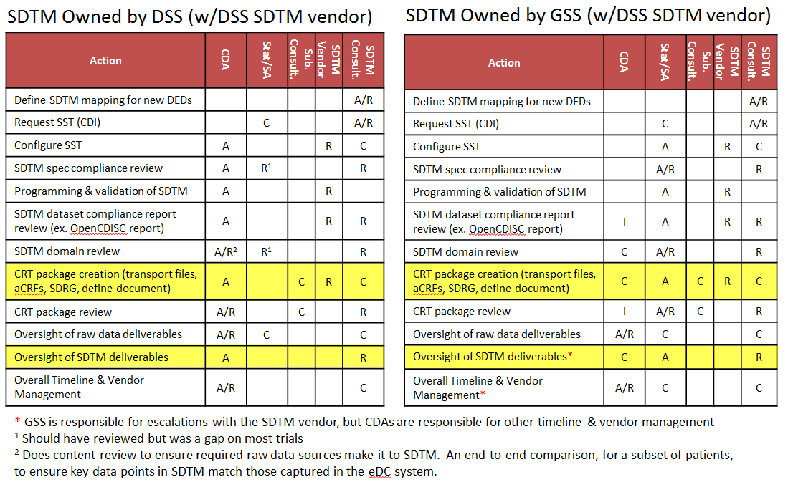
SDTM Roles and Responsibilities
By Sourcing Model
Company Confidential ©2015 Eli Lilly and Company

Slide 51
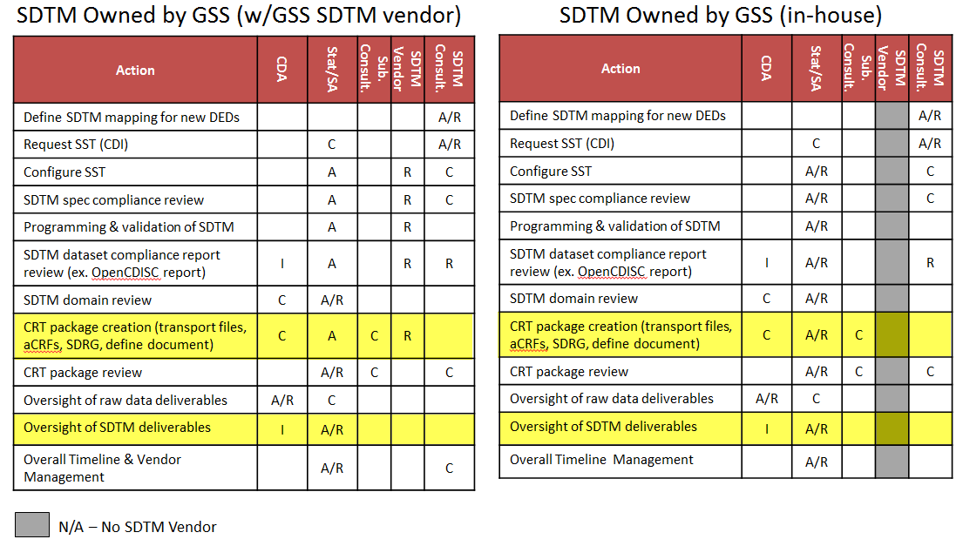
SDTM Roles and Responsibilities
By Sourcing Model
Company Confidential ©2015 Eli Lilly and Company

